Slide 1
Data Visualization and Dashboards with Excel and Cognos
PROFESSIONAL CERTIFICATE IBM Data Analyst

Slide 2
Agenda
Histogram
Filled Map Charts
Dashboarding
Notes:
We will discuss more advanced charts and dashboarding in excel.

Slide 3

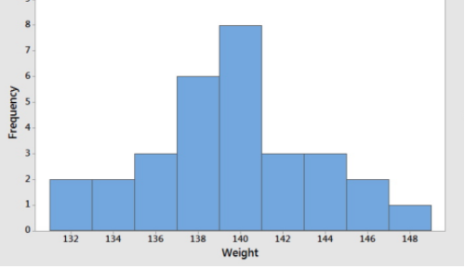
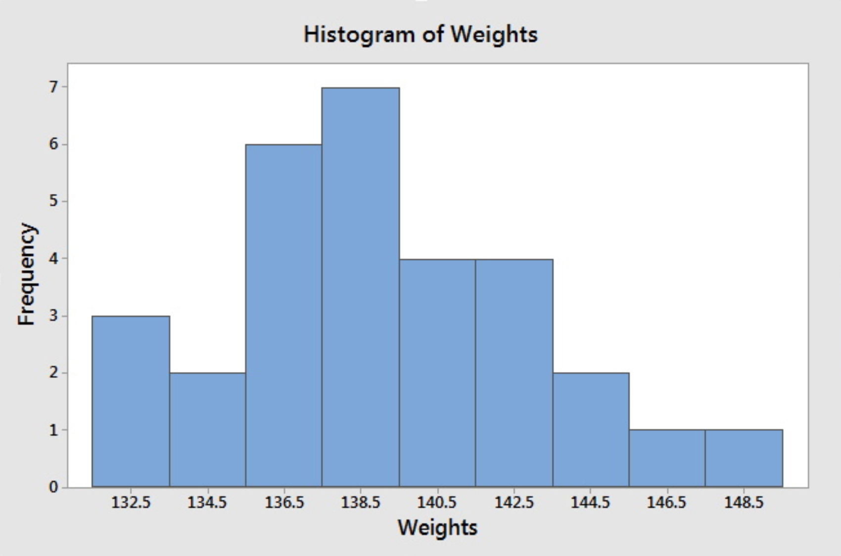
Histogram
Jessica weighs herself every Saturday for the past 30 weeks.
135 | 137 | 136 | 137 | 138 | 139
140 | 139 | 137 | 140 | 142 | 146
148 | 145 | 139 | 140 | 142 | 143
144 | 143 | 141 | 139 | 137 | 138
139 | 136 | 133 | 134 | 132 | 132
131.5-133.5
133.5-135.5
135.5-137.5
137.5-139.5
139.5-141.5
141.5-143.5
143.5-145.5
145.5-147.5
147.5-149.5
https://online.stat.psu.edu/stat500/book/export
Notes:
A histogram is a graph that shows the distribution of the data grouped into bins Although a histogram may look like a column or bar chart it's totally different while a bar chart is used to compare data a histogram is used to display distribution of data.
Table with 30 weighs over 30 weeks.
Two histogram charts with different range intervals, notice how the char change while changing the range.
Ask pps. How we can change the range intervals for the Histogram, and how to change the numbers format tags in the X axis.

Slide 4
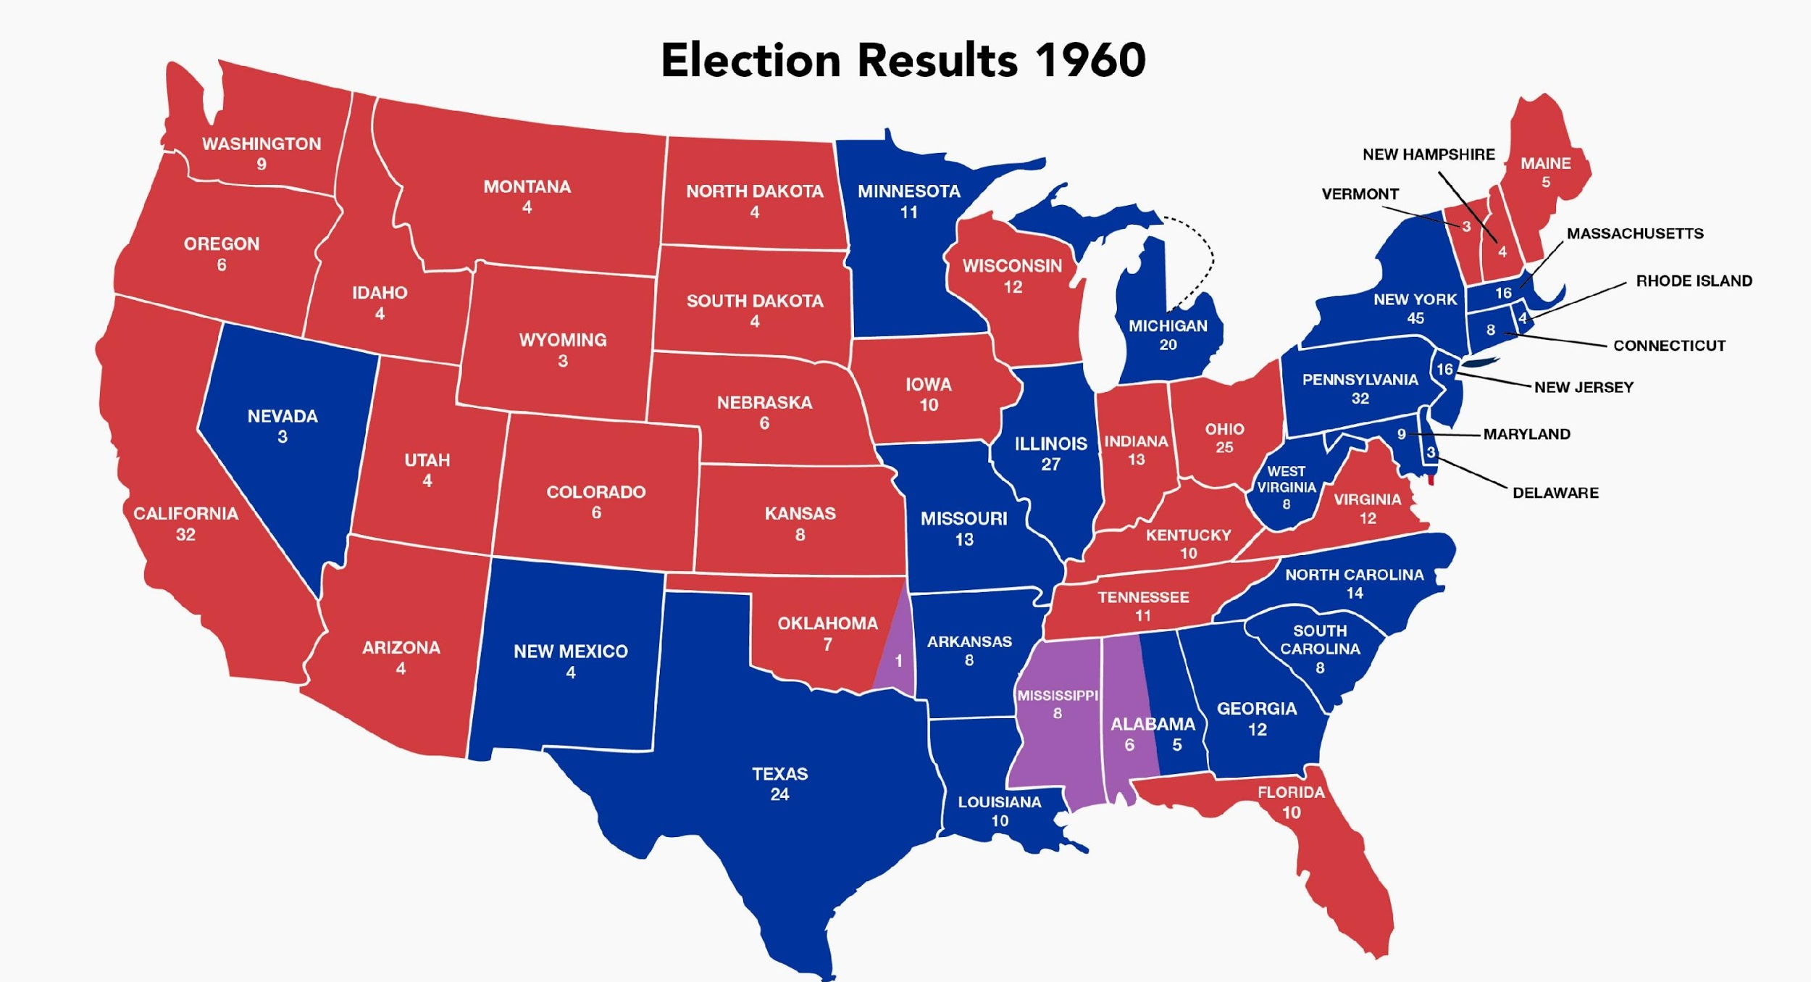
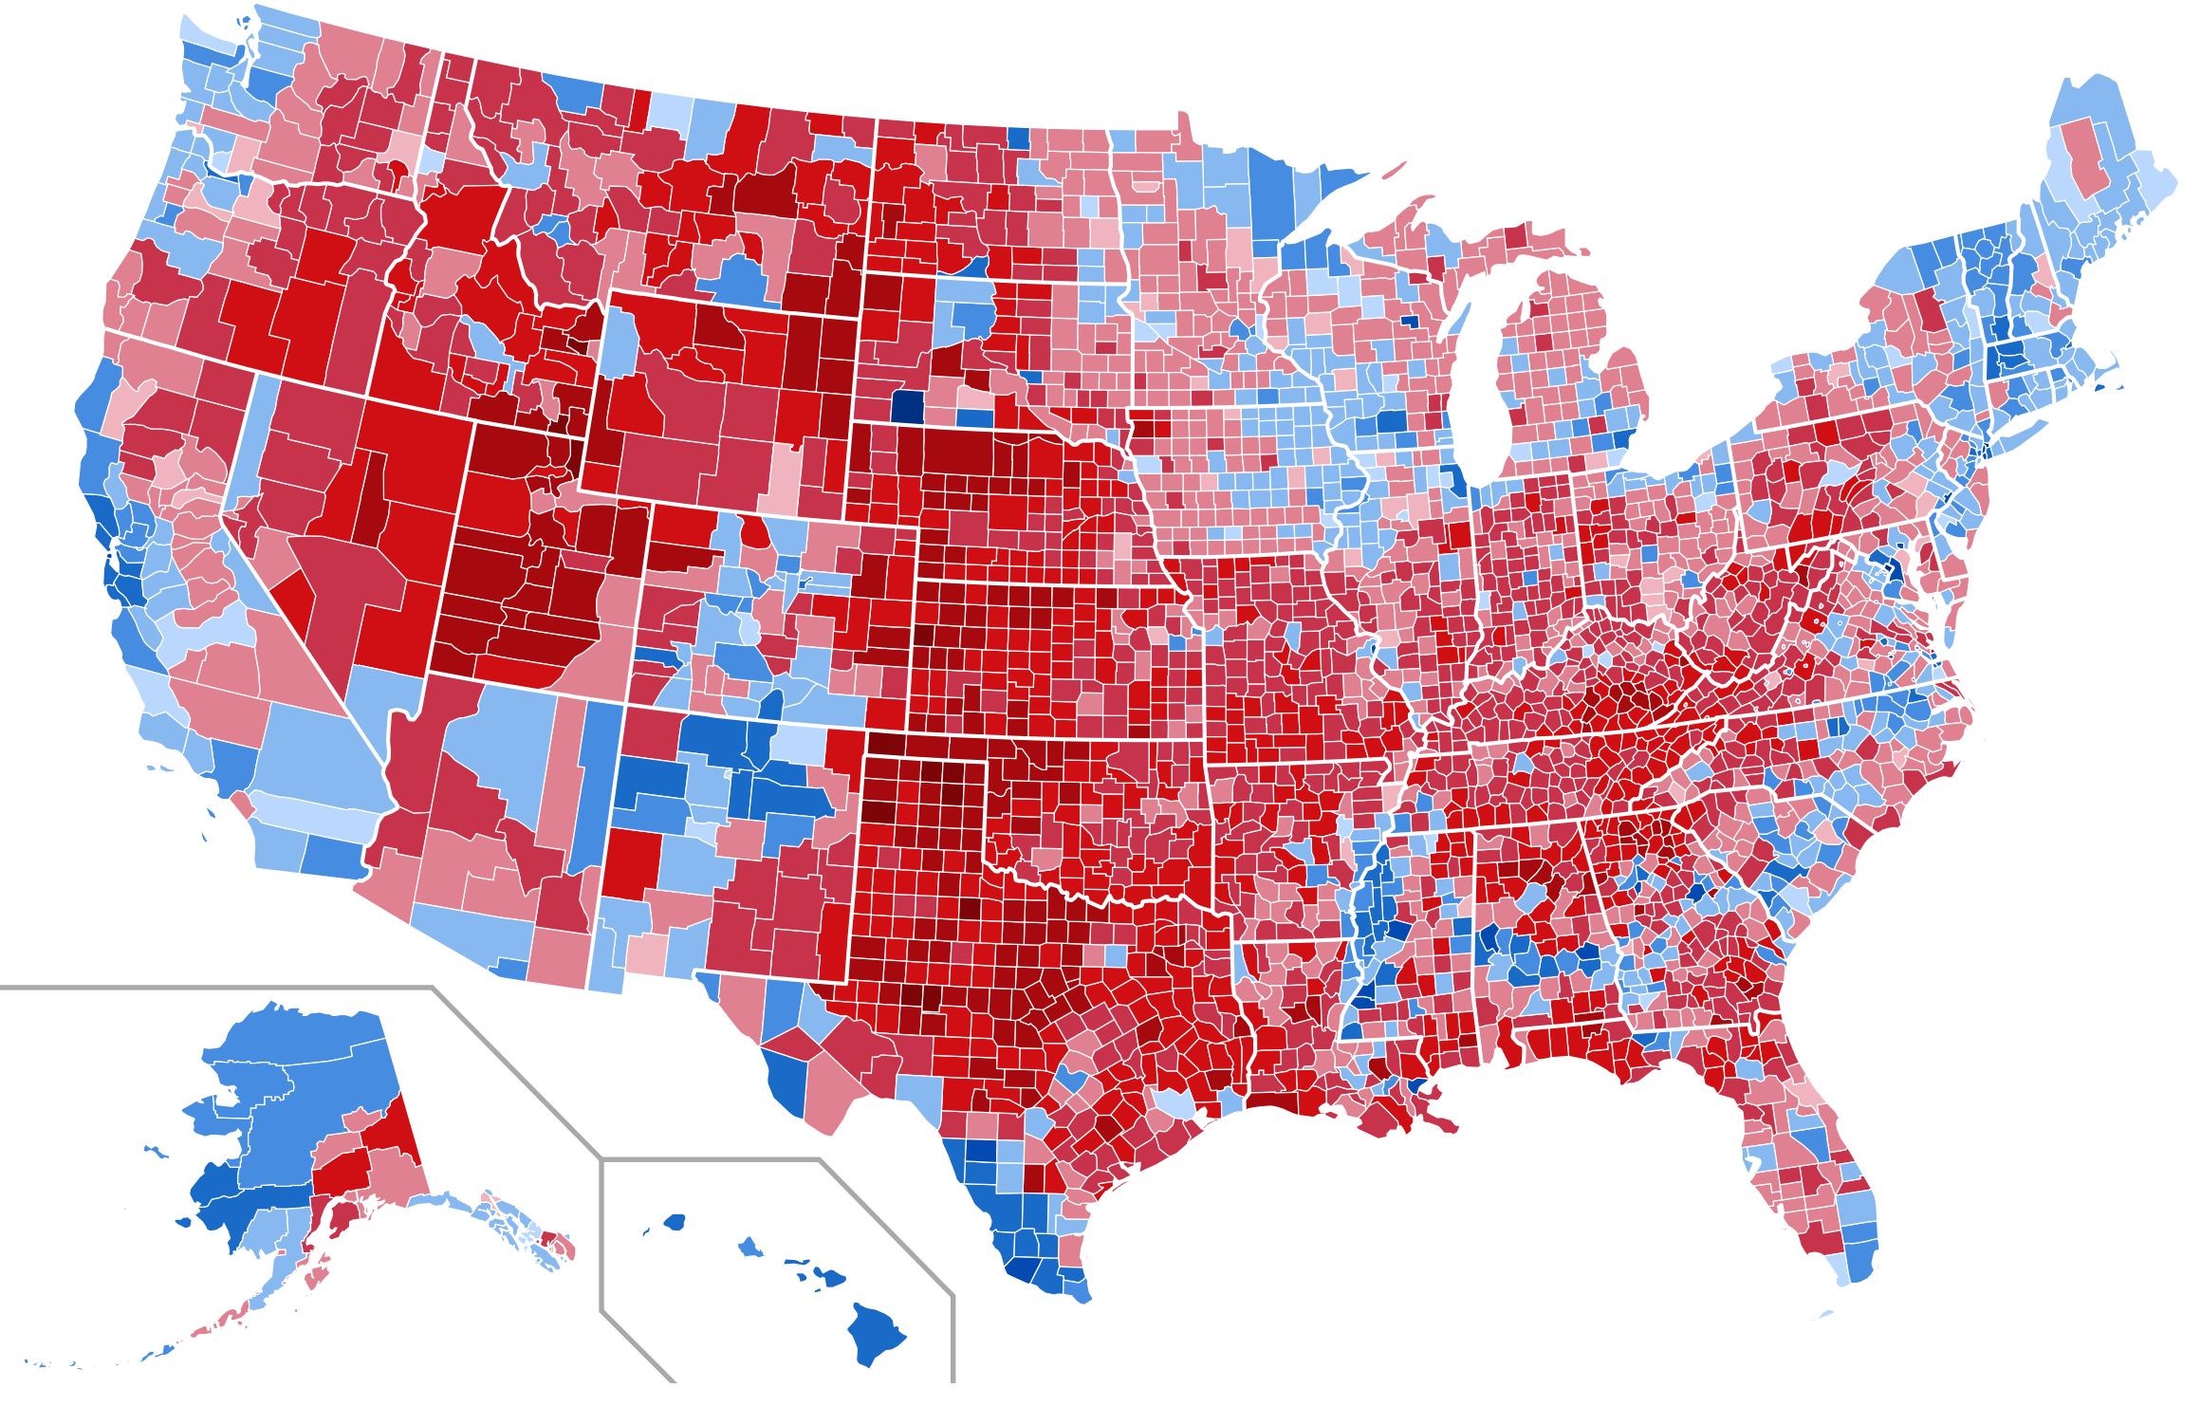
Filled Map Charts
A filled map chart is a type of chart used to compare values and show categories across geographical regions.
jfklibrary.org
socviz.co/maps
Notes:
Ask pps. What they think about each chart. Why the second one is not good.
How can we improve the second one: add more filters, choose appropriate colors, the chart should not be so cluttered

Slide 5
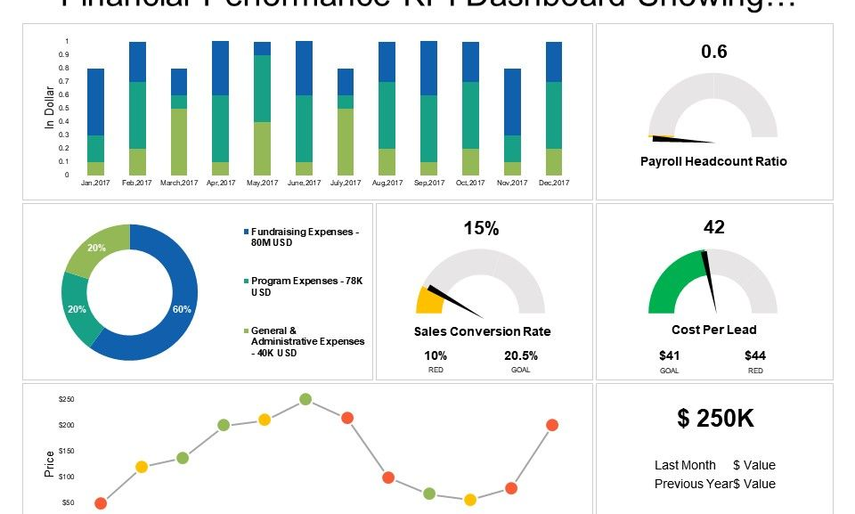
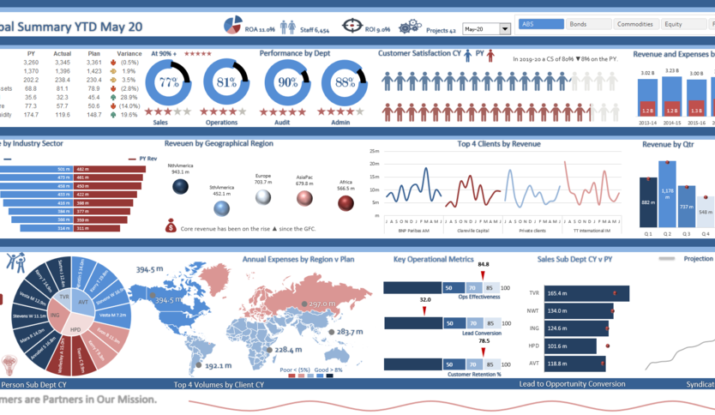
Dashboarding
Discuss in the breakout rooms
The role of dashboarding and why it is an important skill as a data analyst.
How to setup and configure a simple dashboard in Excel.
The importance of dashboards in telling a data-driven story.
Notes:
Ask pps. About their opinion for both charts.
Second chart is very cluttered, and might be misleading and confusing. Don’t achieve the goal of doing a visualization or a dashboarding
First one is clearer, can tell the data story, have more written insights

Slide 6
Practice exercise
Download the Customer_demographics_and_sales.xlxs from Schoology, follow the instructions, and be prepared to share your findings in the main room.

Slide 7
Any questions

